Slide 1
Rescheduling and Pay Protection JCBA Section 10

Slide 2
Basics of Rescheduling 10.J
Line holders are not to be treated like Reserves
Keep the crew together if possible
Catch up Flight Attendant to their original trip
Return to base no later than original trip Date & Time
Reserves flying on days off considered line holders

Slide 3
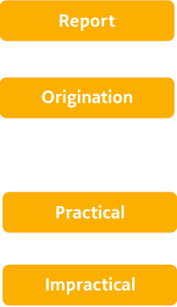
Contractual Terms & Definitions
Sign in time or check in
Departure time of first leg
It is possible to catch up with flying and makes sense
It is possible and legal to catch up with flying but does not make operational sense

Slide 4
Contractual Terms & Definitions
Reroute
Adding a DHD leg to catch up with flying after a cancellation
Reschedule
FA is legal and available but is rescheduled to other flying
Illegal though No Fault
FA becomes FAR or contractual illegal (after award)
FA initiated Split
FA requesting contractual rest, Personal (PO) or sick

Slide 5
A flight segment is considered cancelled when it does not operate
General Information
Sequences may be changed after publication, e.g., equipment change, block times, departure
or arrival times or cancellations
A line holder or reserve on days off is not required to report earlier than the originally scheduled sequence (10.J.2.e)

Slide 6
Rescheduling
Prior to Report – more than 3 days
FA may reject the changed sequence if change includes different:
city pairs
layover cities
number of days in the sequence
arrives later than the originally scheduled sequence
When the FA is notified of the disruption determines more than 3 days or within 3 days.
If FA rejects sequence, there is no pay protection. If FA accepts, pay protected for greater.
If notified and report is earlier, then FA will be pay protected according to Crew Substitution rules
2

Slide 7
Since the number of days of the trip has changed, you can tell Crew Schedule you no longer want the trip.
My last trip of the month changed from a 2 day to a 3 day. Do I have to fly it?
10.J.2.b

Slide 8
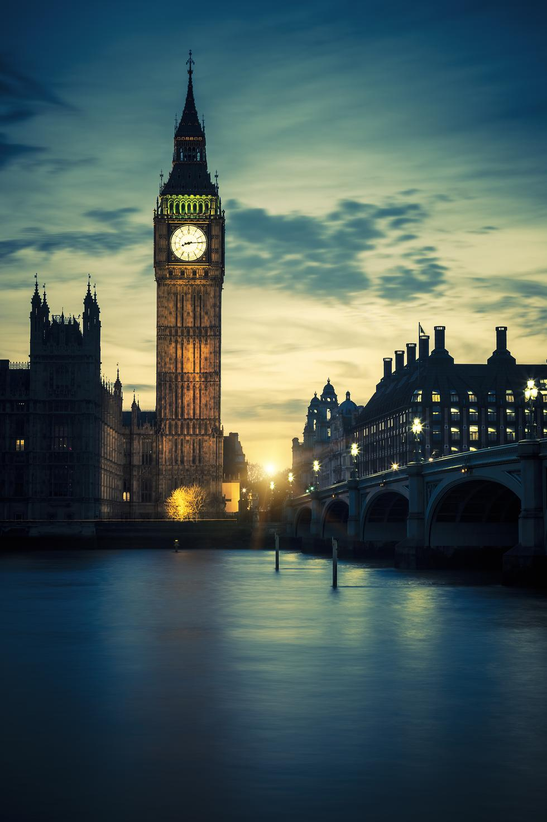
Rescheduling
Prior to Report – within 3 days
2
FA may request to be removed from the sequence if change includes different:
layover cities, city pairs
number of days in the sequence
arrives later than the originally scheduled sequence
needs Crew Schedule Consent
When the FA is notified of the disruption determines more than 3 days or within 3 days.
If FA rejects sequence, there is no pay protection. If FA accepts, pay protected for greater.
If notified and report is earlier, then FA will be pay protected according to Crew Substitution rules

Slide 9
They changed my trip tomorrow that was a long SFO layover, to ABQ now. I don’t want that trip anymore.
When Crew schedule notifies you of the change to your trip you can ask to be removed from that trip. If they can, they’ll replace you.
10.J.2.c

Slide 10
Before you report to work (sign-in):
There’s a change to your trip (city pair, layover city, or duration) that occurs more than 3 calendar days out (section 10.J.2.b)
Remain on trip
You can choose to decline the trip by calling Crew Scheduling or you can remain on the trip
Pay protected
Decline trip
No pay protection
There’s a change to your trip (city pair, layover city, or duration) that occurs within 3 calendar days of your flight (section 10.J.2.c)
Remain on trip
Pay protected
You can choose to decline the trip with Crew Scheduling’s consent or you can remain on the trip
Decline trip
No pay protection
Quick Reference Guide – Company Document

Slide 11
Rescheduling
After Report but Prior to Departure
Full Sequence Cancellation

Slide 12
Rescheduling
After Report – Prior to Departure
Full Sequence Cancellation 10.J.3
Reschedule FA only as necessary in order to prevent a delay or cancellation
(no Reserves available)
In IROPS these provisions are intended for orderly rescheduling procedures
Reasonable effort to reschedule the entire crew together
If full crew is not needed,
Offered in seniority order or
Assigned in inverse seniority order
This Photo by Unknown Author is licensed under CC BY-NC-ND

Slide 13
Rescheduling
After Report – Prior to Departure
Full Sequence Cancellation
FA will only be rescheduled beyond his/her originally scheduled return time if the Company has unsuccessfully made every effort to schedule a reserve
10.J.7
If FA is not notified of the rescheduled assignment within 4 hours of sequence report time or 3 hours after disruption is known, FA is released. 10.J.3.d
Crew Scheduling may release FA prior to this time or FA may contact Crew Scheduling to be released prior to this time
10.J.3.d

Slide 14
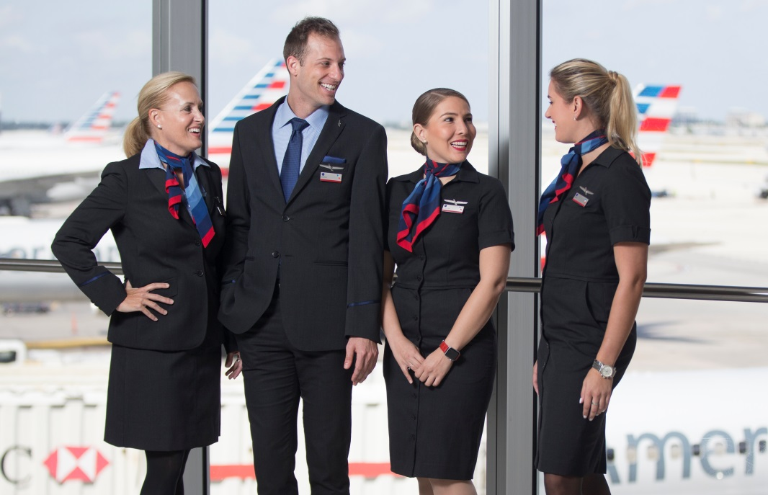
We will receive the greater of the original sequence or actual of the rescheduled sequence for pay.
I cannot be rescheduled because it’s my last trip this month, and I am pay protected (10.L.1)
Our entire sequence cancelled due to a snow storm and 2 of us were rescheduled to a 2 day instead of a 3 day. Are we pay protected?
I’m not rescheduled, and it’s not my last trip of the month, so I only receive 3 hours call out pay.
10.J.3

Slide 15
After you’ve reported (signed-in), but before departure:
All flights
in your trip cancel
If full crew not needed, reschedule offered in seniority order or assigned in inverse seniority order if needed
Crew Scheduling may reschedule you to another trip to prevent a delay or cancellation
Pay protected
Not rescheduled
No pay protection
Quick Reference Guide – Company Document

Slide 16
Rescheduling
After Report but Prior to Departure
Partial Sequence Cancellation of Downline Leg
or Misconnect within the sequence

Slide 17
Crew Tracking makes every effort to return FA back on to original sequence
Reschedule FA only as necessary in order to prevent a delay or cancellation
(no Reserves available)
10.J.3
Make every effort to reschedule no later than the time she/he was originally scheduled to return
10.J.7
10.J.1.c
Rescheduling
After Report – Prior to Departure
Partial Sequence Cancellation or Misconnect
For clarity in IROPS, these provisions are intended for orderly rescheduling procedures in the event of last minute operational irregularities that have a high probability of resulting in sequence delays or cancellations.

Slide 18
After you’ve reported (signed-in), but before departure:
Part of your trip cancels or you misconnect
Crew Tracking may reschedule you to maintain the operation
or
Remove you from the entire trip
Pay protected
Note: Beginning late summer 2018, when the rest of pay protection/rescheduling is implemented (with few exceptions), you’ll no longer be paid for canceled segments if they are not flown by another crew, unless they are part of your last trip/last series
Quick Reference Guide – Company Document

Slide 19
Rescheduling
After Departure
Partial Sequence Cancellation or Misconnect within the Sequence

Slide 20
Rescheduling
After Departure
Crew Tracking makes every effort to return FA back on to original sequence
If FA is not notified of the rescheduled sequence within 3 hours after disruption, FA is released. Crew Scheduling may release FA to the hotel, prior to this time
Make every effort to reschedule no later than the time she/he was originally scheduled to return
10.J.1.c
10.J.4
10.J.7
For clarity in IROPS, these provisions are intended for orderly rescheduling procedures in the event of last minute operational irregularities that have a high probability of resulting in sequence delays or cancellations.

Slide 21
Our first flight was delayed and caused us to miss our next 2 legs to MSP, then on to PHL. So now CS is going to DH us to PHL to catch up to the rest of our sequence.
Another crew flew our 2 legs, so we’ll be pay protected with crew substitution.
10.J.4
10.J.10

Slide 22
Return to Crew Base
Wait, they have reserves in DFW to fly the DFW to SFO leg , and we can deadhead DFW to LAX and get back by 7pm. Let’s call Crew Schedule
Our last leg back from DFW to LAX cancelled this morning, now they want us to work DFW to SFO then DH from SFO to LAX. Now were getting home at 10pm instead of 7pm.
10.J.7

Slide 23
More than Three Hour Delay
(at origination)
We just found out we have a mechanical, and are delayed for 4 hours
I need the pay, I’m staying on the trip, so I’ll call for a day room since it’s longer than 4 hours
OK, I see there are plenty of reserves, so I want to be removed.
I’m calling Crew Schedule and asking to be removed.
We’ve already been here 4 hours, so we will get 1 for 2
10.J.8

Slide 24
More than three-hour delay at origination:
Quick Reference Guide – Company Document

Slide 25
Delayed Flights
(until the Next Day)
You could be delayed to report the next day for your sequence, if CS can catch you up to your sequence and return by your original scheduled arrival time.
10.J.7
You will receive a hotel room and 3 hours call out pay, and the pay for the sequence, if you choose to stay on the trip.
If you choose not to stay on the trip you can request to be removed if reserves are available. You will receive duty rig 1 for 2.
10.J.8

Slide 26
Equipment Substitution

Slide 27
Equipment Substitution - 10.J.9
(Entire Sequence)- Prior to Departure
How many Flight Attendants will be required for the new equipment?
Only the required number of flight attendants will remain on the trip.
Most senior will be released with pay and credit
Speaker will only be removed if another speaker can cover the position (APFA disagrees)
Company will remove non-qualified Flight Attendants first
(APFA disagrees)

Slide 28
Equipment Substitution
(Partial Sequence) – Prior to Departure
All flight attendants will remain as working crew if jump seats are available
If the number of flight attendants exceeds the available jump seats, the most senior flight attendants will be released, but may be required to rejoin later

Slide 29
Changes to equipment substitution:
There’s a full sequence aircraft downgrade
(e.g., B767 to B757)
Most senior FAs released.
Speaker may only be removed if there is a replacement speaker within the crew.
Non-qualified FAs removed
Pay protected
Prior to departure and an overstaffed flight
More FAs than available jumpseats.
Most senior FAs released; may be required to rejoin later in the sequence
There’s a partial sequence aircraft downgrade
(e.g., B767 to B757)
Non-qualified FAs removed from leg(s) & required to deadhead if operationally necessary
Pay protected
Most senior FAs may be released
Pay protected
After departure, not enough jumpseats for original crew
Most senior FAs released at point the trip transits back through base
Pay protected
After departure and the trip passes back through the crew’s base
What’s changing?
The number of FAs required to work may equal the total # of open jumpseats – meaning we may overstaff part of the trip
You may be released from part of the trip, but required to rejoin if it transits back through your base
Quick Reference Guide – Company Document

Slide 30
Crew Substitution
When a Flight Attendant has been removed from a leg(s) in their sequence,
and another crew flies that leg(s),
it’s crew substitution
Pay Protected

Slide 31
Illegal through No Fault
FAR Illegality
Contractual Illegality
Direct Conflict

Slide 32
Illegal through No Fault
FAR Illegality
If you agree to split back on once you become FAR legal, you will be pay protected for the sequence.
If it is impractical to split you back on you will be pay protected for the sequence.
If you decline to split back on, you will be pay protected until you become FAR legal and any legs flown by a substitute crew, up until the point you could have split on.
Includes any Rigs that apply
Your current trip arrives late and you are FAR illegal

Slide 33
Split On or Off a Sequence
When a flight attendant is FAR illegal for only a portion of the sequence
Could be “split off” after flying the beginning of a sequence, but would be removed for the illegal portion of the trip.
This would be at the latest point prior to the illegality
Could be “split on” a sequence if s/he was illegal for the origination, but would be legal for the remainder of the trip.
This would be the earliest convenient time that Crew Schedule would be able to get the FA back onto the sequence.
Crew Schedule procedures:
For FA attendant who is FAR illegal, crew schedule will contact the FA for legal split if possible, or if it is impractical to split FA back onto original sequence. FA will need to let CS know if they choose not to split back onto sequence, otherwise CS will assume you are splitting on to the sequence.

Slide 34
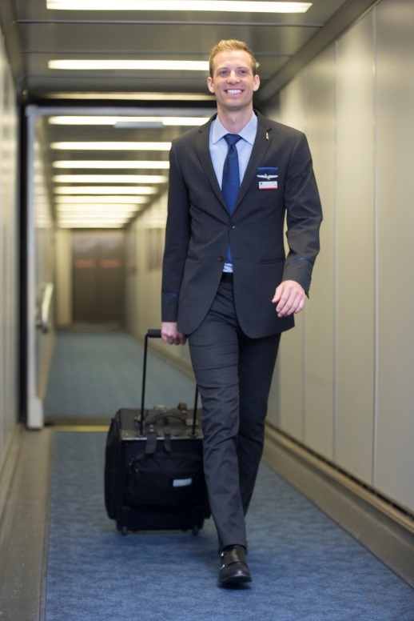
I have a SFO-JFK trip tomorrow and less than 8 hours rest due to a delay. Yeah, I’m pay protected for my trip tomorrow.
10.K.1

Slide 35
Illegal through No Fault
Contractual Illegality 10.K
If your current trip arrives late and you fall below contractual rest, Crew Schedule will not remove your next trip.
The assumption will be, that you want to keep the trip
To be removed, you will need to contact Crew Schedule at the conclusion of your current trip
You may ask to be split on when you are legal, if you split on this is considered FA initiated split. 10.M.3
There is no pay protection if you are removed from the trip
Rigs and Daily Avg do not apply

Slide 36
You don’t have to lose your trip anymore, you’ll keep it unless you call Crew Schedule
Oh no, I’m 10 minutes late, I really don’t want to lose my Rome trip
10.K.1

Slide 37
Illegal through No Fault
Direct Conflict
Your trip arrives after you were supposed to report for your next trip
You will be removed from the second trip
Pay Protected for the combined value of the original trips
*If possible, you could be split back onto your sequence when legal

Slide 38
Illegal through No Fault
Mid-Sequence
If the trip passes through base split you off at the latest point prior to becoming illegal. If you do not pass back thru base, then split off at point you become illegal and DH back to base.
You become FAR illegal after you originate your trip
10.K.3
Before you report it’s known you were legal to originate but FAR illegal to complete your sequence
10.K.2
24/7
FAR Rest

Slide 39
When you are illegal through no fault of your own for all or a portion of your trip:
Join next trip at point you become FAR legal (split on)
Pay protected
FAR illegal to originate next trip because current trip runs late
(section 10.K.1)
Impractical to split on
Pay protected
Pay protected, including rigs, until you could have been split back onto the trip.
Decline split on
What’s changing?
FAR (vs. contractual) legalities come into play
You can be split back on/off your trip already in progress
If you want your contractual rest, please call Crew Scheduling after the completion of your late arriving trip or it’s assumed you’re waiving it
Two trips with no overlap but FAR illegal
Paid the greater of scheduled or actual hours of the first trip plus the value of the second trip
Pay protected
Two trips overlap
(direct conflict)
Paid hours are based on the combined value of both scheduled trips
Pay protected
You become FAR illegal after originating your trip
(section 10.K.3)
If trip passes back through base, will split off trip at latest point before you are illegal
Pay protected
If not passing back through base, will split off at point you become illegal & deadhead you back to base
Pay protected
Before you report, legal to originate, but FAR illegal to complete your entire trip
(section 10.K.2)
If trip passes back through base, will split off trip at latest point before you are illegal
Pay protected
If not passing back through base, will split off at point you become illegal & deadhead you back to base
Pay protected
Quick Reference Guide – Company Document

Slide 40
Last Sequence/Last Series
Last Sequence
The last sequence on the schedule for the flight attendant
This could be anytime in the month, for example the 5th, the 17th or the 28th of the month
Last Series
Multiple trips back to back without a calendar day off between trips
There is no maximum for the number of days within a series
Pay Protection
When a trip is cancelled in it’s entirety, flight attendant is pay protected
If illegal thru no fault for the last trip of the month, pay protected, no split
If first leg is cancelled, Crew Schedule may split on to remainder of trip
If illegal after origination, Crew Schedule may split off at point of illegality
Pay Protection is for Entire Sequence

Slide 41
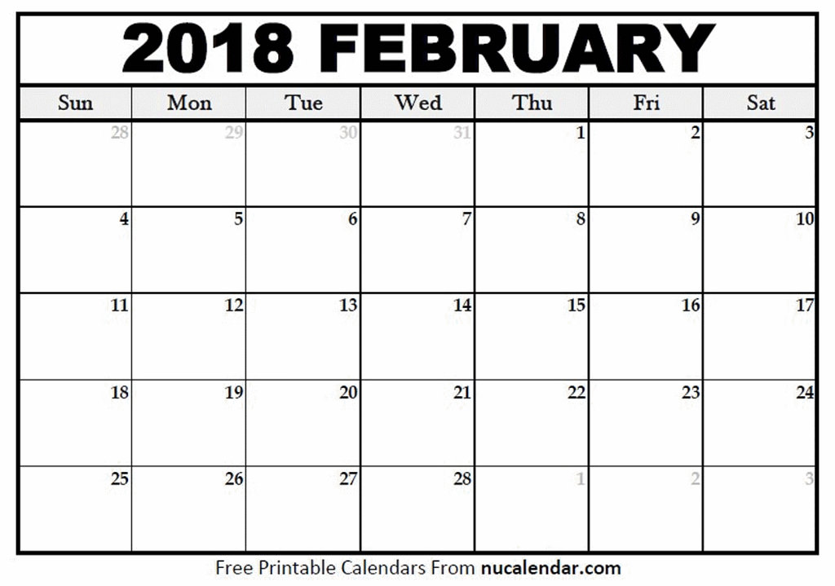
Last Sequence/Last Series
My last day of work is on the 18th, then I go on vacation. If any of my trips from the 14th to the 18th cancel or I go illegal, I’m pay protected!
Seq
123
Seq
123
Seq
123
Seq
234
Seq
234
Seq
234
Seq
679
Seq
679
VC
VC
VC
VC
VC
VC
10.L
VC

Slide 42
Last Sequence/Last Series
My last trip of the month was on the 9th and the first leg cancelled and they took me off the rest of the trip and can’t split me on.
You are pay protected, and if you pick up another trip after the 11th, then you will not be pay protected under last trip/last series for any time after the 11th. All other pay protections still apply.
You only have one last trip of the month protection
Seq
476
Seq
476
Seq
476
Seq
879
X
Seq
879
X
Seq
879
X
10.L

Slide 43
Last Sequence/Last Series
I had a delay on the 16th that made me illegal for my trip on the 17th. They split me onto my seq 369 later on the 17th to catch up to the rest of my trip.
Seq
145
Seq
145
Seq
376
Seq
376
Seq
376
Seq
246
Seq
369
Seq
369
Seq
876
Seq
953
10.L

Slide 44
Premium Pay
When a flight attendant is pay protected,
it is inclusive of all premiums from the
original trip
International
Galley
Purser
Aft
Speaker
Except:
Where the payment of such premium is excluded elsewhere in the agreement
Premiums are not paid for sick, training, holding pay, jury duty, bereavement, holiday, settling/moving days and call out pay
10.V.4

Slide 45
Pay Protection Miscellaneous
If you receive Location Delay Incentive pay (LE) it will be measured against any pay protection you receive
The union has a grievance over how the company is currently paying (LUS) and plans to pay for trips in August, that involve cancelled segment(s) and where you have Rescheduled, Crew Substitution or Equipment Substitution
The union has filed a grievance over the two phases of pay protection for LAA flight attendants

Slide 46
First Phase of Pay Protection LAA
May 2018

Slide 47
May 2018 Changes
MIC IPP
L5D
obligation

Slide 48
Line Holders will no longer see a guarantee
There will no longer be a MIC obligation for pay protection.
If the last trip originating in the last 5 days cancels or you are FAR illegal, you will be pay protected without any obligation, including carry over time.
Reserves will keep a 75 hour guarantee

Slide 49
Last 5 Day Pay Protection Changes May 2018 until “2nd Phase”
 |  |  | 24 | 25 | 26 | 27
28 SEQ | 29 SEQ | 30 SEQ | 31
Last Trip Originating Last 5 Days
Cancels No Obligation
FAR Illegal No Obligation
Paid in month SEQ terminates
 |  |  | 24 | 25 | 26 | 27
28 | 29 | 30 | 31 SEQ | 1 SEQ | 2 SEQ | 3
Last Trip Originating Last 5 Days Carry Over
Cancels No Obligation
FAR Illegal No Obligation

Slide 50
Changes to last trip of the month originating in the last 5 days of the month:
Your last trip originating in the last 5 days of the month cancels or you’re FAR illegal to originate
Pay protected including carryover time without having an obligation
(Pay protection will be paid in the month the trip terminates)
Note: changes from last trip in the last 5 days of the month to last trip or series of trips- anticipated change in late summer. (section 10.L.)
Pay protected
What’s changing? You’re fully pay protected without any obligation to be available for another flying assignment
Quick Reference Guide – Company Document

